Slide 1


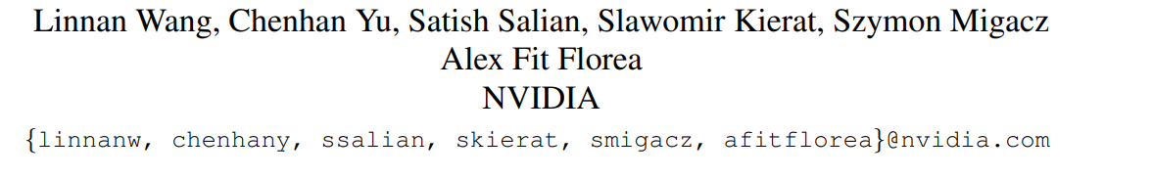
Searching the Deployable Convolution Neural Networks for GPUs
IEEE / CVF Computer Vision and Pattern Recognition Conference (CVPR 2022 – CCF A)
Name: Sohaib 宋海泊
Date：2023.11.15
知行合一、经世致用
自强不息 厚德载物
自强不息 厚德载物
Tsinghua University of China
Central South University

Slide 2
1
Introduction
Customizing Convolution Neural Networks (CNN) for production use has been a challenging task for DL practitioners.
DL researchers have been dedicated to inventing new building blocks, while DL engineers deploy these building blocks in real-world tasks, painstakingly recombine them to find architectures that meet the design requirements.
Most of the time, we can simplify these requirements to find the best-performing architecture on the target device (e.g., GPUs) within a specific latency budget.
Though there are many exciting advancements in the neural network designs, e.g., the residual connection, Inverted Residual Block (IRB) and the attention, deploying these network designs remains challenging and laborious; and this is the problem to be addressed in this paper.
自强不息 厚德载物
Central South University

Slide 3
2
Contributions
The system is a novel distributed NAS with three main components: a search space, an evaluation module, and a search method, designed to optimize network architectures with exceptional accuracy and efficiency.
The search space is highly comprehensive, allowing for the customization of numerous parameters such as filter numbers, kernel sizes, layer quantities, and input resolutions, along with specific configurations within IRBs and Fused-IRBs, as used in EfficientNet.
Unlike other systems, this NAS evaluates network candidates through training rather than estimation from a supernet. This method, while more resource-intensive, ensures more accurate ranking of architectures.
To handle the computational demands, a client-server-style distributed system was implemented, effectively scaling up to 300 A100 GPUs across 40 DGX-A100 nodes, showcasing its robust scalability and performance.
The system employs Learning Search Space Partition for Black-box Optimization using Monte Carlo Tree Search guided Bayesian Optimization as its search method, chosen for its demonstrated sample efficiency in recent black-box optimization challenges.
This NAS system surpasses previous works in leveraging accuracy and latency, addressing limitations found in fixed filter patterns (NASNet), activation/SE patterns (FBNetV3), and scaling strategies (EfficientNet).
自强不息 厚德载物
Central South University

Slide 4
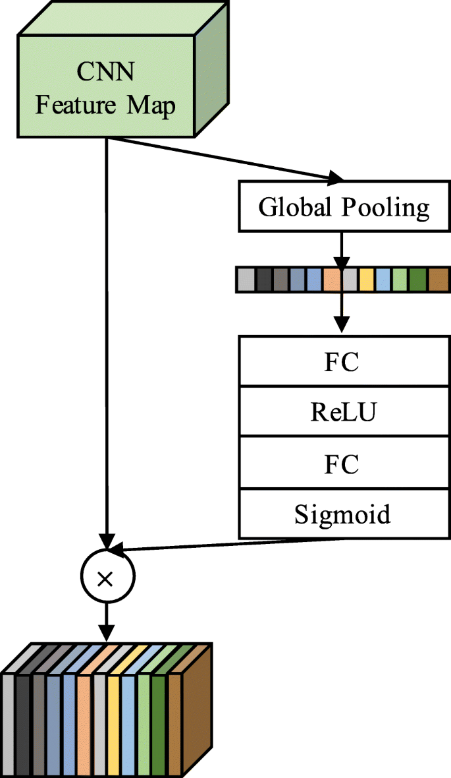
2
Cont.
The system's search space is uniquely comprehensive, incorporating a wide range of parameters like filter numbers, kernel sizes, number of layers or IRBs, and input resolution. Within IRBs or Fused-IRBs, it further allows customization of the expansion ratio, activation type, and the inclusion or exclusion of the SE block.
This expansive search space facilitates superior optimization of both latency and accuracy. It addresses and surpasses the limitations of previous works such as NASNet's fixed filter pattern and FBNetV3's fixed activation and SE pattern, as well as the rigid scaling strategy in EfficientNet. This leads to more efficient and effective network designs.
To effectively handle the complexity of this search space, the system evaluates network candidates by training them, rather than relying on supernets. Although resource-intensive, this approach ensures a more accurate and reliable ranking of architectural designs, contributing to the development of highly optimized neural networks.
自强不息 厚德载物
Central South University

Slide 5
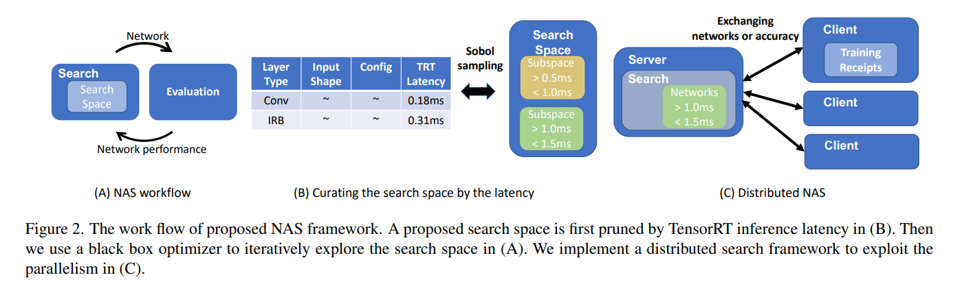
3
Methodology
The system employs a novel two-stage NAS framework, specifically designed for optimizing models on GPUs. The first stage involves categorizing network architectures based on inference latency, while the second stage focuses on optimizing accuracy within each latency-defined subgroup.
The search algorithm initially selects networks from a vast, high-dimensional search space using Sobol sampling. It approximates network latency with a latency lookup table based on input data shape and layer configurations. In the subsequent iterations, the algorithm refines its choices by analyzing the accuracy of previously evaluated networks, thus continuously improving the selection process.
In its second stage, the system utilizes Bayesian optimization to identify the most efficient network within a specific latency range. This process is supported by a robust client-server distributed framework, where the server proposes networks for evaluation, and the clients return the network's accuracy after training.
自强不息 厚德载物
Central South University

Slide 6
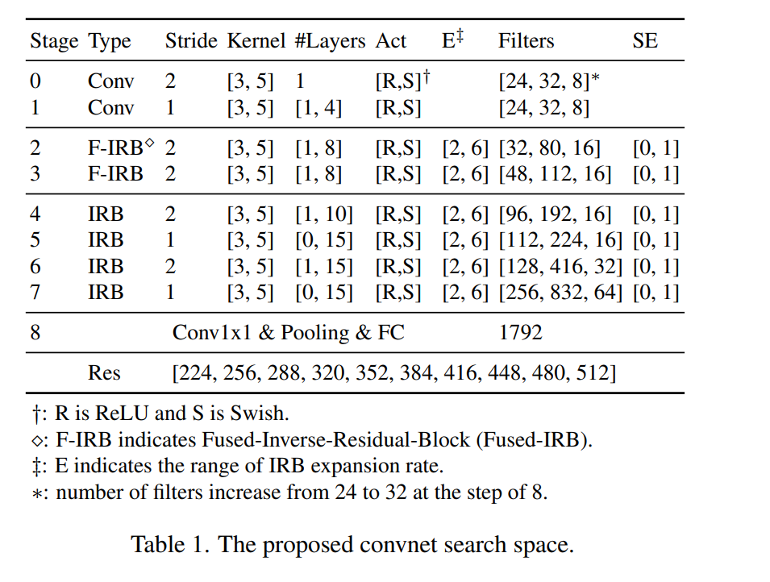
3
Search Space
The framework's search space is modeled after EfficientNet. This design choice reflects a focus on ConvNets due to their better support in current technologies, with the exploration of transformer or MLP-based models in visual tasks planned for future work.
Table 1 demonstrates the details of our search space used in this paper.
Search space consists of 8 stages.
Inspired by EfficientNet-V2, the 2 and 3 stages uses Fused-IRB.
Latency > if rest of the IRB replaced with Fused-IRB.
#Layers shows the range of #layers in the stage, e.g., [3, 10] at stage 4
means that the stage can have 3 to 10 IRBs.
The search space includes options to tune expansion ratio, activation types,
kernel sizes.
The dimensions of the input image increase from 224 to 512 at the step of 32.
自强不息 厚德载物
Central South University

Slide 7
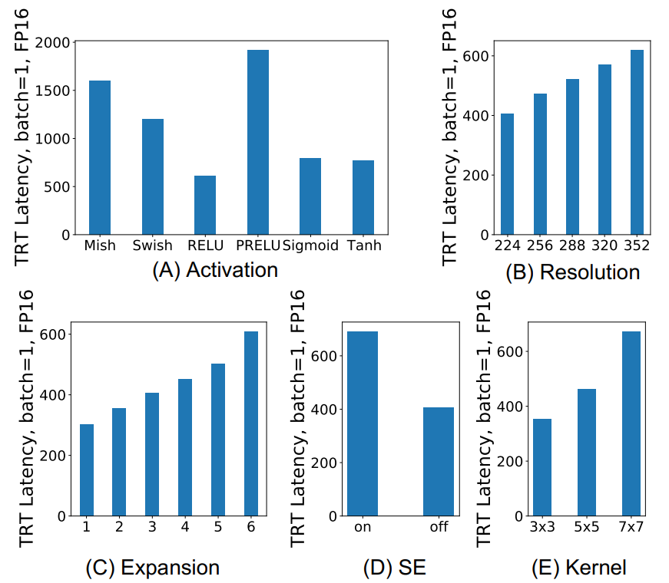
3
Justifications of the Search Space
#Layers and Filters.
Activation → ReLU can be 4x faster than using PReLU.
The choice of activation is an important factor in the latency
and accuracy trade-off.
Expansion: MobileNet paper claims that the larger expansion
will help improve the capacity of the network and expressiveness.
For example, the accuracy of a network drops 4 points on
ImageNet after reducing the expansion from 6 to 2.
Kernel: large kernels = large receipt field = increase accuracy
SE: latency significantly increases. This justifies SE to be a factor
in the search space.
Image Resolution: accuracy improvement by increasing the
resolution
自强不息 厚德载物
Central South University

Slide 8
3
Distributed Neural Architecture Search
Guided by validation accuracy as a reward, the search algorithm adjusts the hyper-parameters defined in the search space to enhance model performance.
LA-MCTS boosted Bayesian optimization as the search algorithm, which is one of the top entries to the 2020 NeurIPS black-box optimization.
LA-MCTS boosted BO has demonstrated the leading sample efficiency among other BO variants and evolutionary algorithms.
Unlike some previous methods that use Multi-Objective Optimization to balance latency and accuracy, this approach avoids the complex and costly process of finding the perfect Pareto frontier. The Pareto frontier represents the ideal balance between latency and accuracy, but finding this balance can be excessively detailed and expensive, especially when the differences in outcomes are minor.
Focusing on Latency First, Then Accuracy: The strategy is to first organize networks based on their inference latency and then focus on maximizing accuracy within each latency category. This approach simplifies the optimization process and allows for the creation of a network table categorized by latency, making it more practical and efficient.
自强不息 厚德载物
Central South University

Slide 9
3
Distributed NAS
The NAS is executed on a distributed system comprising clients and a server. The server generates a range of network designs based on latency, which forms the search space. Clients, when available, request these network designs from the server, evaluate them, and send back the results, including the best validation accuracy achieved. This continuous exchange of information via sockets allows the server to refine its search algorithm and propose increasingly effective network candidates.
The system's efficacy is tested using synthetic functions to ensure that the performance metric improves with an increasing number of samples.
自强不息 厚德载物
Central South University

Slide 10
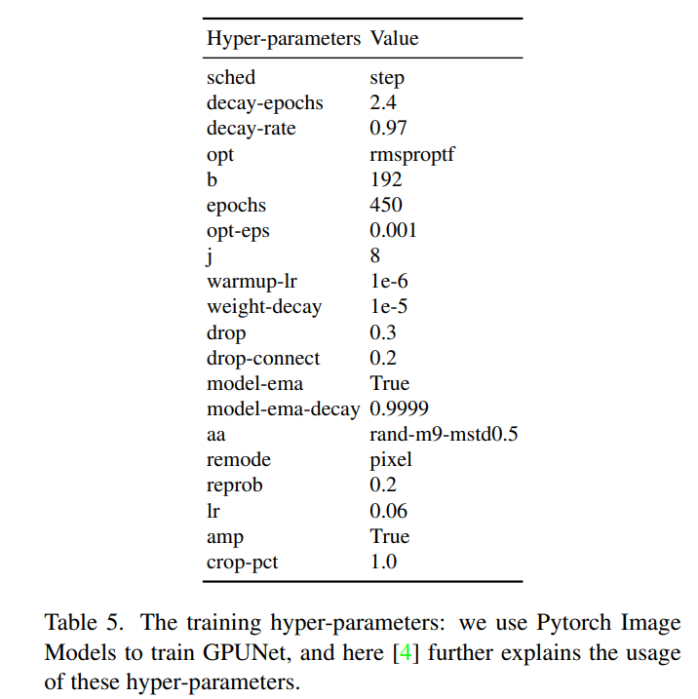
4
Experiments
ImageNet [11] that contains 1.28 million training and 50000 validation
images in 1000 classes.
Random augmentation at the magnitude of 9 and a standard deviation of 0.5.
Machine Setup: Perform the training on DGX A100 with 8x A100 80 GB.
Each proposed network by training and apply the early-stopping.
Used Pytorch Image Models in training, and we applied the same
configurations to all GPUNet.
自强不息 厚德载物
Central South University

Slide 11
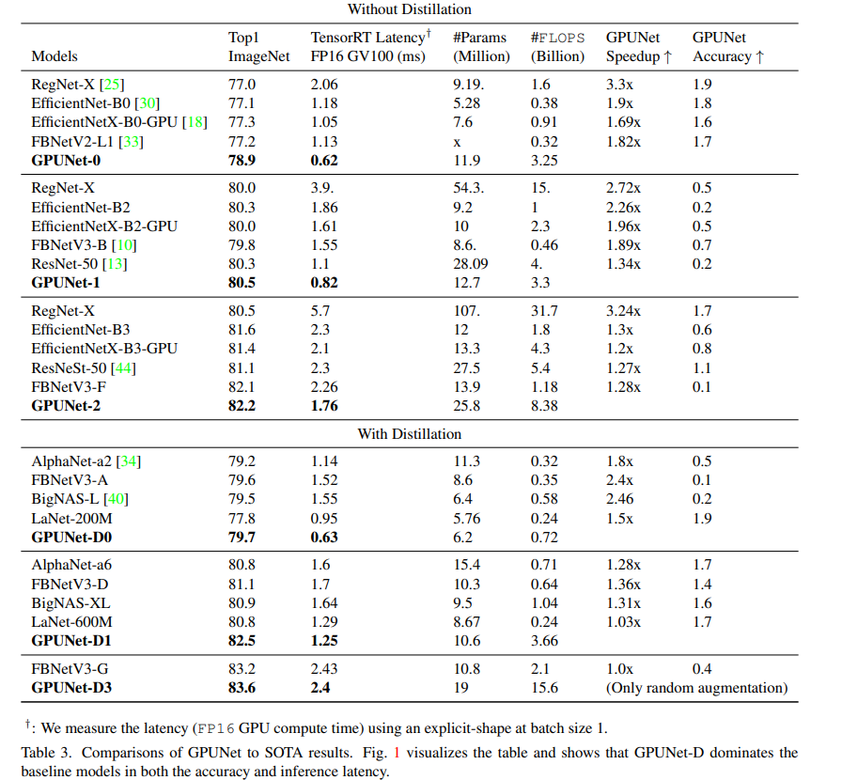
4
Results on ImageNet1K
GPUNet and GPUNet-D are significantly faster than SOTA networks
while maintaining similar accuracy.
At the similar 80.5 top-1 accuracy, GPUNet-1 is nearly 2 times
faster than EfficientNet-B2, EfficientNetX-B2-GPU, and
FBNetV3-B.
GPUNet consistently demonstrates the speedup from 1.27× to
3.24× than baselines.
#FLOPS and #Parameters of GPUNet are larger than baselines,
though GPUNet is significantly faster.
These results indicate that low FLOPS models are not necessarily
fast on GPUs.
自强不息 厚德载物
Central South University

Slide 12
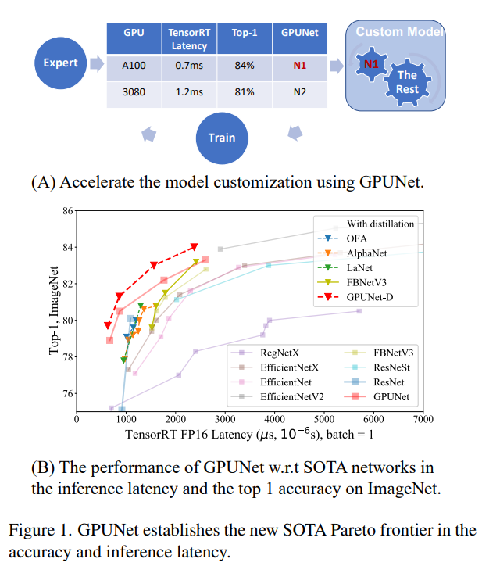
4
Results on ImageNet1K
GPUNet-D, for the cases of with/without distillation.
EfficientNet-V2 shows slightly better results than GPUNet when latency > 3ms.
GPUNet-D dominates other models in both target objectives
自强不息 厚德载物
Central South University

Slide 13
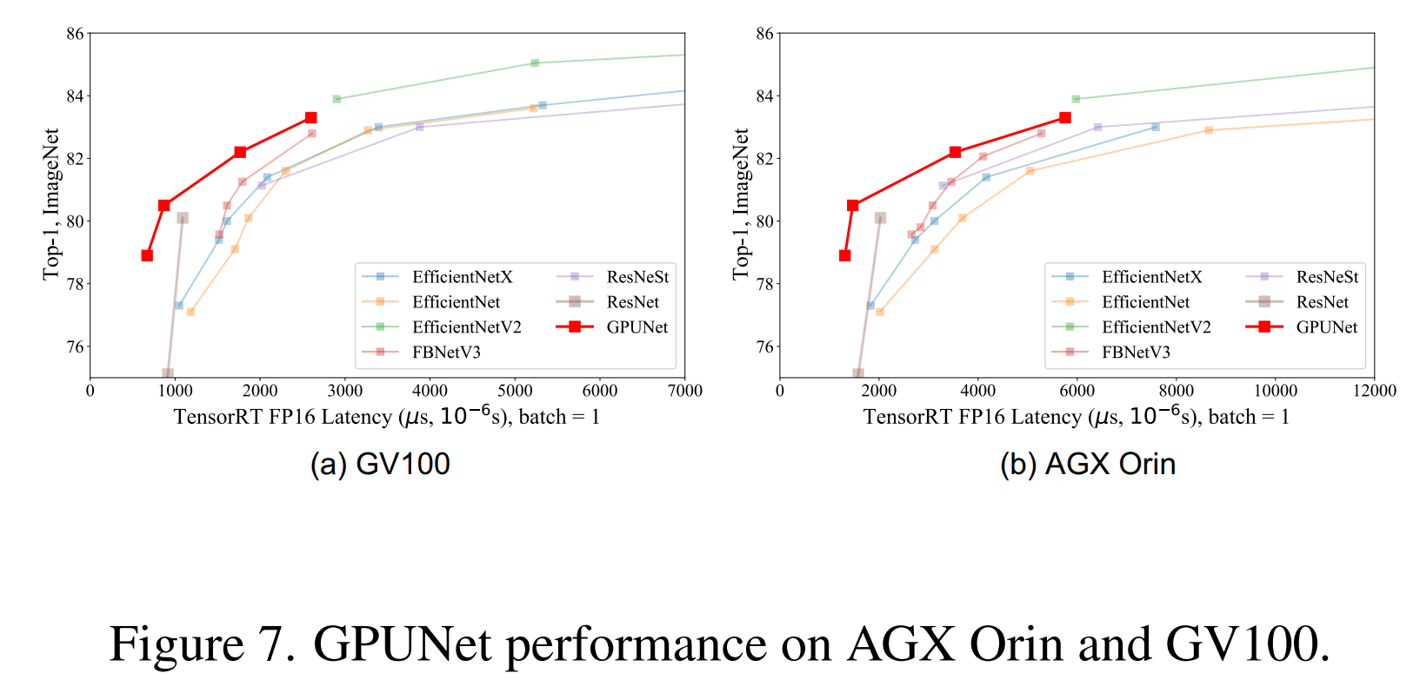
4
Verify the models on more devices
Advantages of GPUNet-2 and GPUNet-3 (latency > 3000 on Orin) decrease on Orin w.r.t on GV100.
Because GV100 has more execution units than Orin, increasing filters or layers can better saturate the device.
自强不息 厚德载物
Central South University

Slide 14
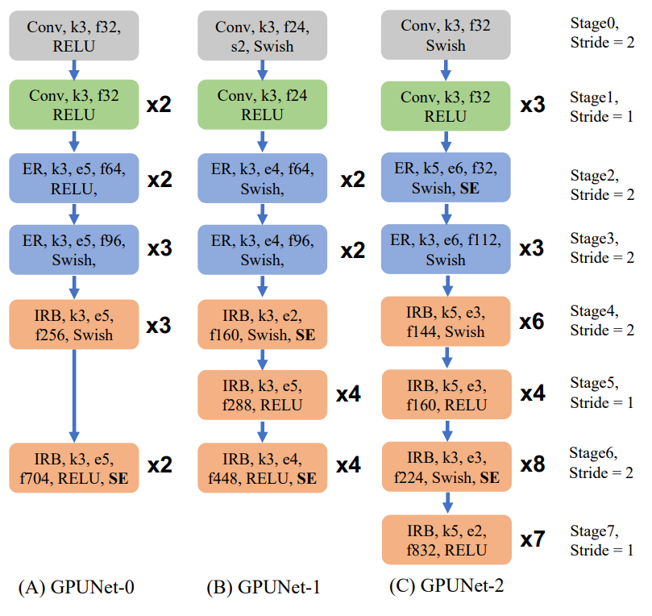
4
Why GPUNet Are Faster and Better?
Mixed Activation Types: GPUNet alternates between ReLU and Swish activations for different layers, unlike EfficientNet and FBNet which consistently use Swish. This mix helps GPUNet reduce latency, allowing room for other accuracy-improving features like larger filters.
Controlled Expansion in IRB: GPUNet often opts for smaller expansions in its Inverted Residual Blocks (IRB) compared to other models, effectively reducing network latency.
Wider and Deeper Network Design: Thanks to savings in latency from mixed activation types and fewer expansions, GPUNet tends to have a wider (more filters) and deeper (more layers) structure than FBNet and EfficientNet, contributing to its superior accuracy.
Higher Resolution: GPUNet uses larger image resolutions compared to EfficientNet and FBNet, improving its accuracy but also resulting in higher FLOPS.
自强不息 厚德载物
Central South University

Slide 15
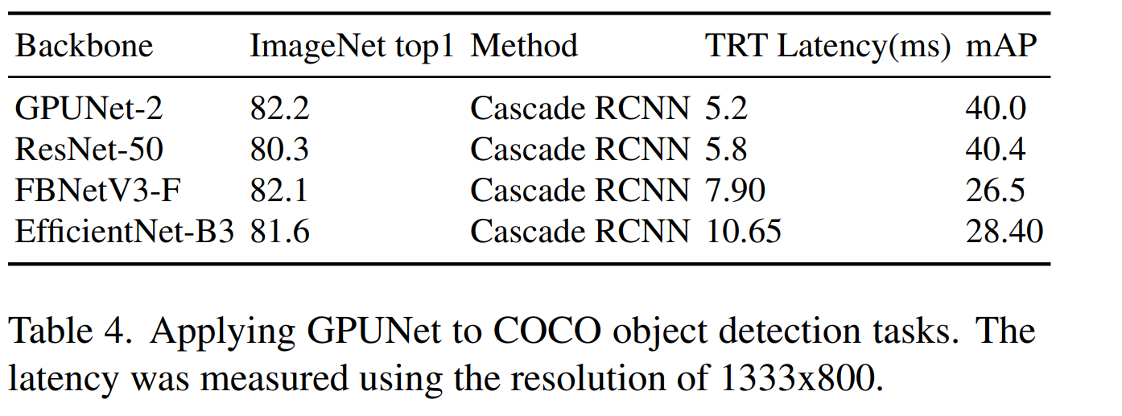
4
Evaluating on Detection tasks
We test GPUNet on COCO detection tasks.
GPUNet-2 is not only faster, but also delivers higher mAP than baseline models.
自强不息 厚德载物
Central South University

Slide 16
5
Conclusion
A model hub is created, categorized by inference latency, to aid in the easy selection and use of pre-trained models with known compatibility and performance metrics.
Innovative Distributed NAS System: The project employs a cutting-edge distributed Neural Architecture Search system with an advanced search space to develop the efficient and high-performing GPUNet models.
Setting New Standards in Performance: This approach establishes a new benchmark in balancing latency and accuracy, showcasing the NAS system's effectiveness in achieving state-of-the-art results.
Flexible and Adaptable NAS Framework: While focusing on EfficientNet, the NAS framework is designed to be adaptable, capable of supporting various tasks and search spaces.
Ongoing Updates for NAS Models: The hub is committed to continuously integrating the latest technological advancements in NAS-optimized models, serving as a dynamic resource for machine learning practitioners..
自强不息 厚德载物
Central South University

Slide 17


Thanks For Listening

